Slide 1

Library Borrower
System
Present by: Iris Kamylle Rivera

Slide 2


Introduction
My Library Management System is designed to make library operations smoother and more efficient. For librarians, it provides tools to add and remove books, view available books, and manage user accounts.
For students, the system offers a simple way to borrow and return books, see what books are available, and keep track of the books they have borrowed. Students also receive notifications about due dates.
Purpose
The main purpose of this system is to make library management easier and more effective. It helps librarians handle their tasks more efficiently and makes it easier for students to access library resources.
Relevance and Usefulness
This system is important because it helps libraries stay organized and user-friendly. It solves common problems for both librarians and users, making library management and usage more convenient.

Slide 3

Significance
This system greatly benefits both librarians and students. For librarians, it makes managing the library's operations more efficient. For users, the system simplifies the process of borrowing and returning books and helps them stay updated with notifications about due dates. This system makes the library work better and be more useful for everyone.

Slide 4
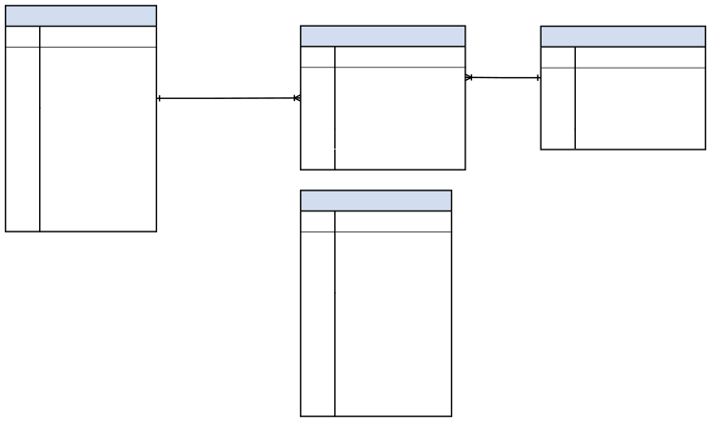
ERD
tbl
PK
u_id
borrowings
books
u_fname
PK
bor_id
PK
book_id
u_lname
FK
book_id
book_name
u_email u_username
FK
u_id
Author
Status
quantity
u_password
borrow_date
publisher
u_status
return_date
u_type
Number
librarian
u_image
PK
u_id
u_fname
u_lname
u_email u_username
u_password
u_status
u_type
Number
u_image

Slide 5

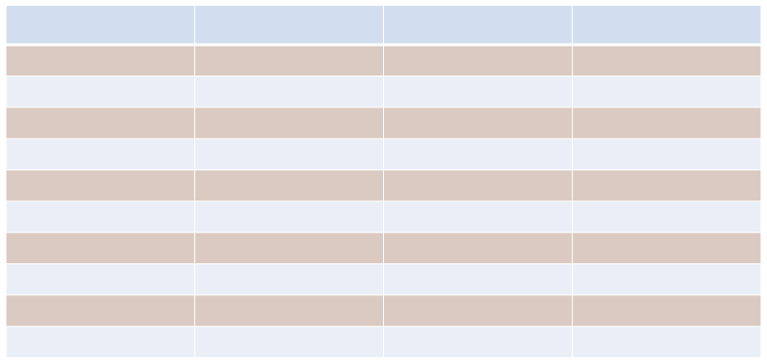
Table Name: tbl
Field Name
u_id
u_fname
u_lname
u_email u_username u_password u_status
u_type
Number
u_image
Data Type
INT
VARCHAR VARCHAR VARCHAR VARCHAR VARCHAR VARCHAR VARCHAR VARCHAR
VARCHAR
Field Length
20
50
50
50
50
150
50
50
11
100
Constraint
Primary Key
Not Null
Not Null
Not Null
Not Null
Not Null
Not Null
Not Null
Not Null
Not Null

Slide 6
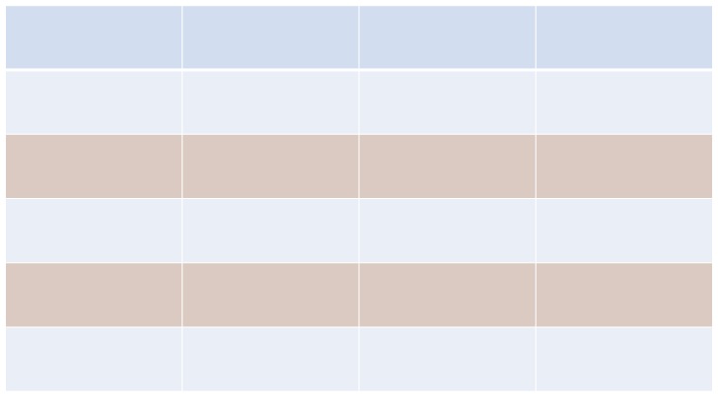
Table Name: books
Field Name
book_id
DataType
INT
FieldLength
20
Constrait
Primary Key
book_name
VARCHAR
50
Not Null
Author
VARCHAR
50
Not Null
Quantity
INT
20
Not Null
publisher
VARCHAR
50
Not Null

Slide 7
Table Name: librarian
Field Name
u_id
u_fname
u_lname
u_email u_username u_password u_status
u_type
Number
u_image
Data Type
INT
VARCHAR VARCHAR VARCHAR VARCHAR VARCHAR VARCHAR VARCHAR VARCHAR
VARCHAR
Field Length
20
50
50
50
50
150
50
50
11
100
Constraint
Primary Key
Not Null
Not Null
Not Null
Not Null
Not Null
Not Null
Not Null
Not Null
Not Null

Slide 8
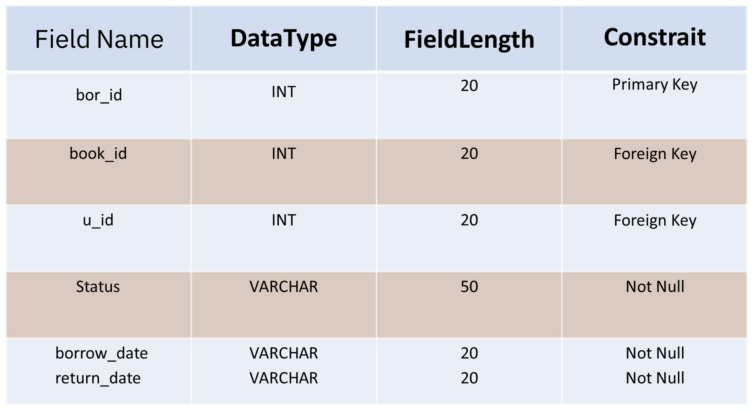
Table Name: borrowings

Slide 9
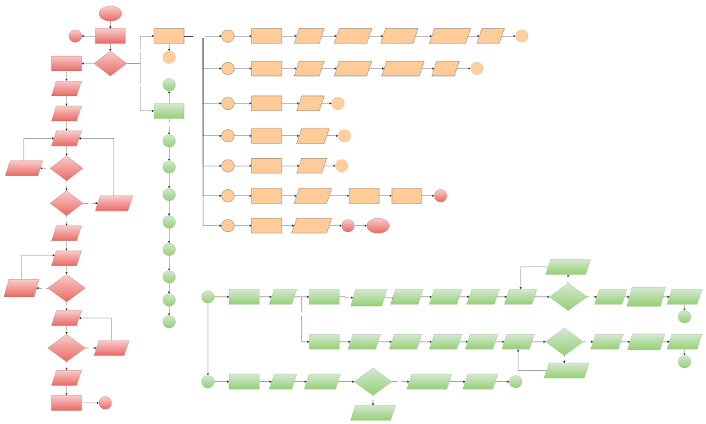
Flowchart
START
L
Login Form
User Dashboard
OPTIONS
op1
BORROW
Display Table
Select Book to Borrow
Select Date to Return
Display “Borrow request submitted successfully”
Display Updated Table
U
Yes
U
Register Form
Account Exist?
op2
RETURN
Display Table
Select Book to Return
Display “Book returned successfully”
Display Updated Table
U
Enter First Name
Yes
A
op3
VIEW AVAILABLE BOOKS
Display Table
U
Enter Last Name
Admin Dashboard
OPTIONS
VIEW BORROWED BOOKS
Display Borrowed Table
Enter Email
A1
op4
U
Display “Invalid email format!”
No
Is Email valid?
A2
op5
VIEW NOTIFICATION
Display Notification
U
Yes
Change Password
Change Password Form
Is Email Duplicate?
Display “Email already exists”
A3
op6
VIEW PROFILE
Display User Profile
L
Yes
No
A4
op7
LOGOUT
Display “Logout Successful!”
L
END
Enter Number
Enter Username
A5
Display “Quantity must be a valid number”
Display “Username already exists”
Is Username Duplicate?
A6
No
Yes
A1
ADD BOOKS & EDIT
Display Table
ADD BOOKS
Enter Book id
Enter Book name
Enter Author
Enter Publisher
Enter Quantity
Is Quantity valid?
Select Type
Display “Book added successfully” Table
Display Updated Table
A7
Yes
NO
OPTIONS
Enter Password
A8
A
Display “Username already exists”
EDIT BOOKS
Enter Book id
Enter Book name
Enter Author
Enter Publisher
Enter Quantity
Is Quantity valid?
Yes
Select Type
Display “Book added successfully” Table
Display Updated Table
Is Password valid?
No
Yes
No
A
Display “Quantity must be a valid number”
Select Type
A2
REMOVE BOOKS
Display Table
Enter Book id to remove
Is BookID valid?
Yes
Display “Book removed successfully”
Display Updated Table
A
Click Register
L
No
Display “No book found with the provided Book ID”

Slide 10
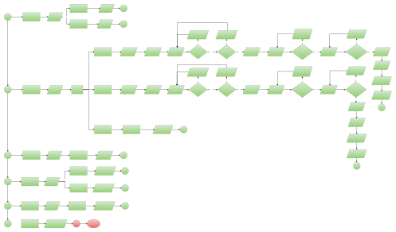
Flowchart
PRINT TABLE
Display Print Table
A
A3
VIEW AVAILABLE BOOKS
Display Table
OPTIONS
PRINT
Display Print Table
A
Display “Invalid email format!”
Display “Email already exists”
Display “Username already exists”
Display “Username already exists”
No
Yes
Yes
No
ADD
Enter First Name
Enter Last Name
Enter Email
Is Email valid?
Yes
Is Email Duplicate?
No
Enter Number
Enter Username
Is Username Duplicate?
No
Enter Password
Is Password valid?
Yes
Upload Image
Display “Email already exists”
Display “Username already exists”
Display “Username already exists”
Select Type
Display “Invalid email format!”
No
Yes
Yes
No
Display “Username already exists”
A4
VIEW USERS
Display Table
OPTIONS
EDIT
Enter First Name
Enter Last Name
Enter Email
Is Email valid?
Yes
Is Email Duplicate?
No
Enter Number
Enter Username
Is Username Duplicate?
No
Enter Password
Is Password valid?
Display Updated Table
Yes
Upload Image
A
Select Type
DELETE
Transform Information to Archive
Display Updated Table
A
Display “Username already exists”
A5
REPORTS
Display Table
PRINT REPORTS
Display PRINT
A
Display Updated Table
Display "Record deleted successfully"
A
A
DELETE
A6
ARCHIVES
Display Table
OPTIONS
RESTORE
Display "Record restored successfully"
A
A7
REQUEST
Display Table
APPROVE
Display "Request approved."
A
A8
LOGOUT
Display “Logout Successful!”
L
END

Slide 11
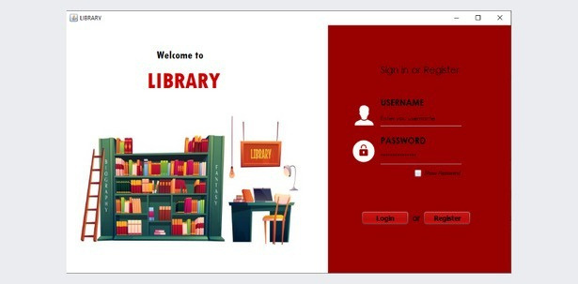
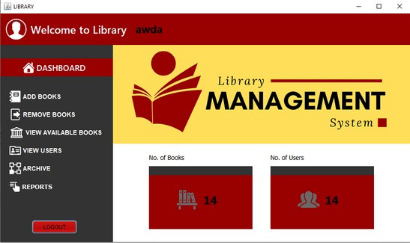
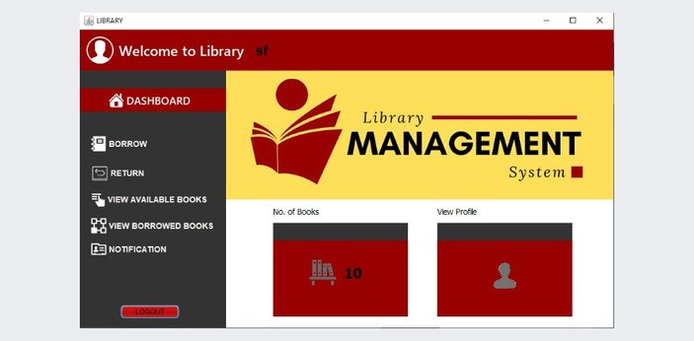
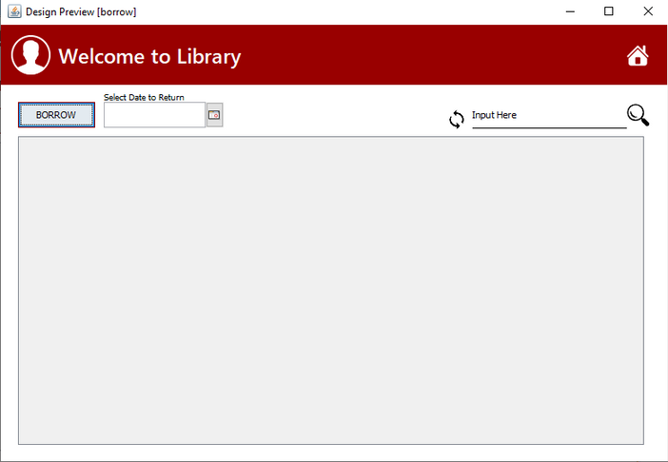
When logged in as an Admin, this dashboard, known as the Admin Dashboard, will be display to you.
Ensure that your login credentials are accurate to access the respective dashboards.
-------------------------------------------------------------------
User Dashboard To access the User Dashboard, just enter your username and password in the Login Frame. Upon logging in,
User can borrow books, return books, view available books, view borrowed books, notification, and profile.
However, when you logged in as a User, This User Dashboard, will be shown to you.
By clicking “BORROW” will take you to this frame where you can borrow a book.

Slide 12
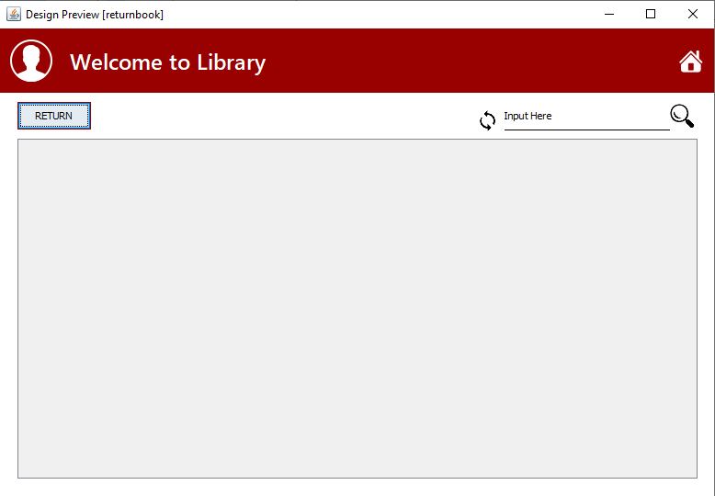
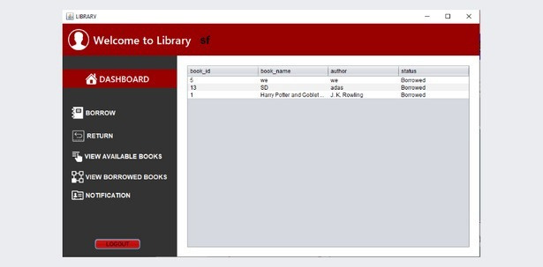
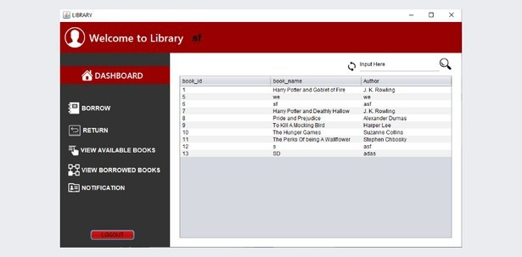
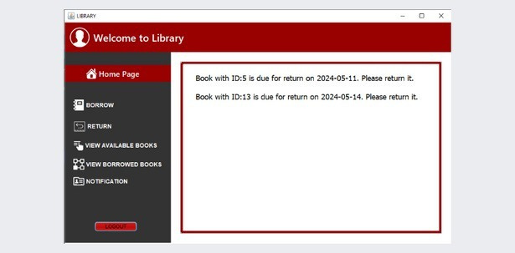
By clicking “VIEW BORROWED BOOKS” you will be taken to this frame where you can see a list of all the books you have currently borrowed.
By clicking “RETURN” will take you to this frame where you can return a book you borrow.
By clicking "NOTIFICATION" you will be taken to this frame where you can see if you have any notifications.
By clicking “VIEW AVAILABLE BOOKS” you will be taken to this frame where you can see a list of all the books.

Slide 13
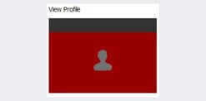
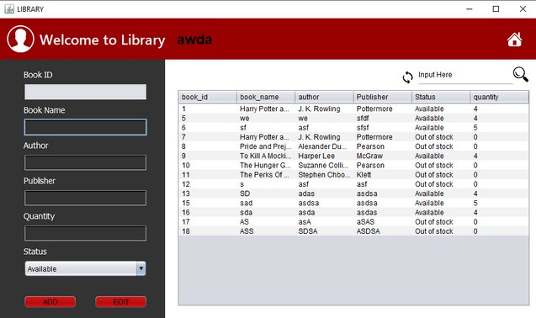
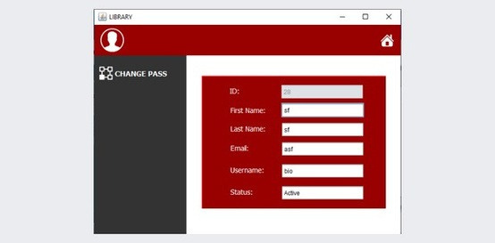
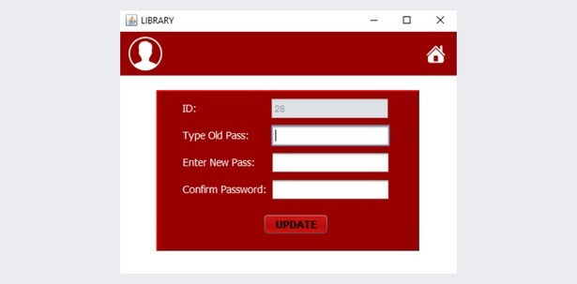
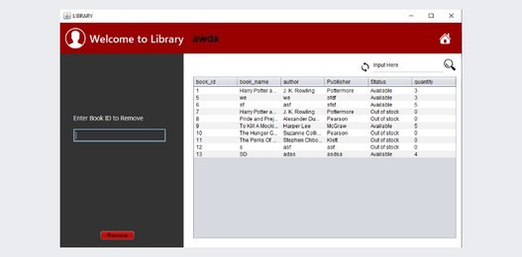
Clicking on this will redirect you to this frame where you can view your information.
By clicking “ADD BOOKS” will take you to this frame where you can add a book or edit a book.
By clicking on "CHANGE PASS" you will be directed to this frame where you can update your password.
-------------------------------------------------------------------
Admin Dashboard To access the Admin Dashboard, just enter your username and password in the Login Frame. Upon logging
in, Admin can add books, remove books, view available books, view users, and reports.
By clicking “REMOVE BOOKS” will take you to this frame where you can remove a book.

Slide 14
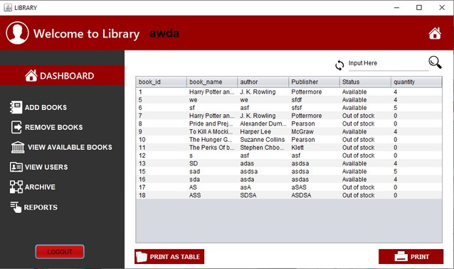
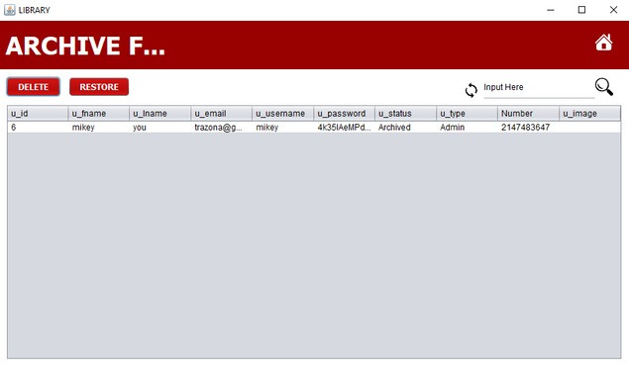

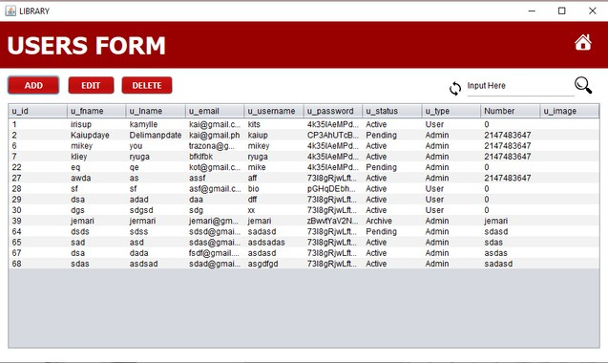
By clicking “VIEW AVAILABLE BOOKS” you will be taken to this frame where you can see a list of all the books.
You can also print as table or individual.
By clicking on "ARCHIVE" you will be directed to a page where you can see the list of archived users.
By clicking on “DELETE” allows you to permanently remove the user. By
clicking on “RESTORE” to bring back the chosen user.
Clicking on "VIEW USERS" will take you to a page displaying a list of all users.
Clicking "ADD" allows you to add a new user or admin.
Clicking "EDIT" enables you to modify the information of the user you selected.
To remove a user/admin and move it to the archive, click the "DELETE" button.

Slide 15
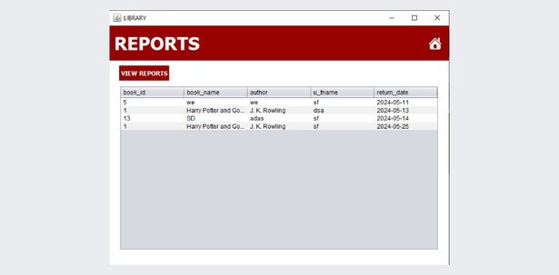
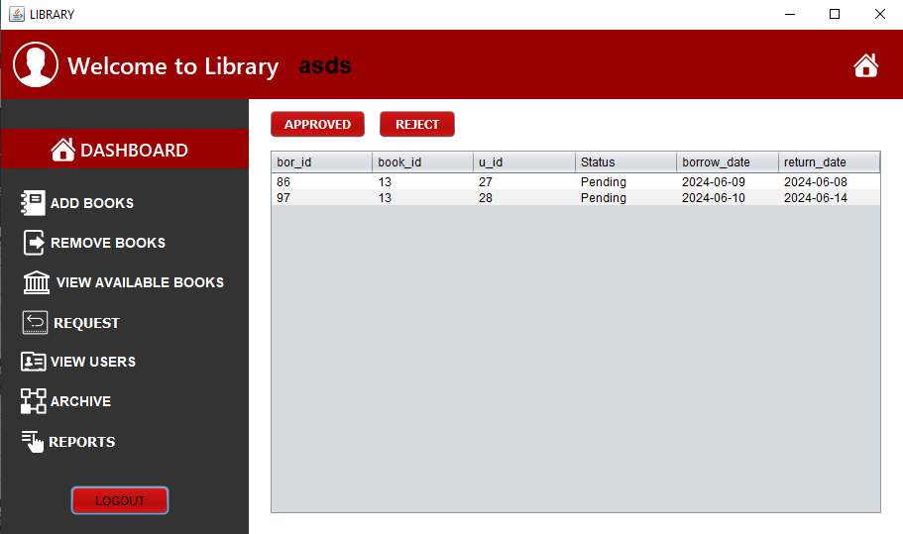
Clicking on "REPORTS" will lead you to this frame where you can see the users who have borrowed books.
Clicking on “VIEW REPORTS” to print out specific records of book borrowers.
Clicking on "REQUEST" will lead you to a page where you can view the list of users requesting access.
Clicking on "APPROVE" will confirm the selection of the book.

Slide 16


THANK YOU

